Slide 1
Ai2c technician lesson 99: Modeling / NLP

Slide 2
ML Intro / Review

Slide 3
Classical Programming vs Machine Learning
Rules
Classical
Programming
Answers
Data
Data
Machine
Learning
Rules
Answers
Let’s look at some things we can do with machine learning.

Slide 4
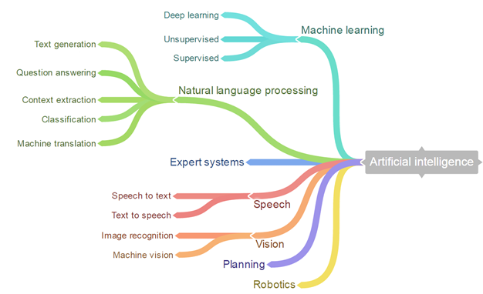
AI Applications
Reinforcement
Notes:
Right now, neural networks are the ONLY scalable deep learning algorithm.
Data mining is the data-focused intersection of AI/ML

Slide 5
Supervised Learning
Machine learning tasks that use historic data (i.e., some “truth”) to guide the learning (aka “train the model”)
Two primary tasks
Classification – predict category
Regression – predict numeric value

Slide 6
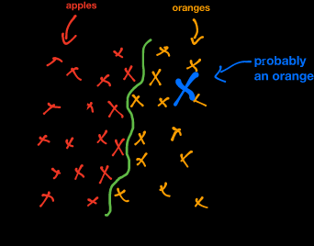
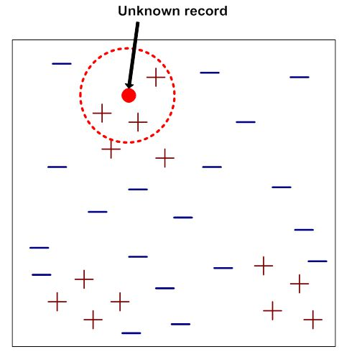
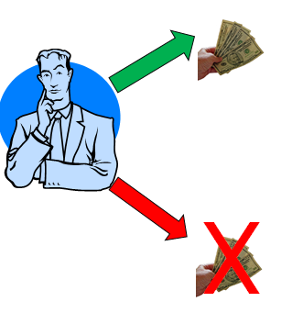
Machine Learning Tasks
Classification
For each example in a population, identify what category the individual belongs in.
Related idea – class probability estimation
What is the probability that the individual belongs to each class?
Notes:
Classification and class probability estimation attempt to predict, for each individual in a population, which of a (small) set of classes this individual belongs to. Usually the classes are mutually exclusive. An example classification question would be: “Among all the customers of MegaTelCo, which are likely to respond to a given offer?” In this example the two classes could be called will respond and will not respond.
For a classification task, a data mining procedure produces a model that, given a new individual, determines which class that individual belongs to. A closely related task is scoring or class probability estimation. A scoring model applied to an individual produces, instead of a class prediction, a score representing the probability (or some other quantification of likelihood) that that individual belongs to each class. In our customer response scenario, a scoring model would be able to evaluate each individual customer and produce a score of how likely each is to respond to the offer. Classification and scoring are very closely related; as we shall see, a model that can do one can usually be modified to do the other.

Slide 7
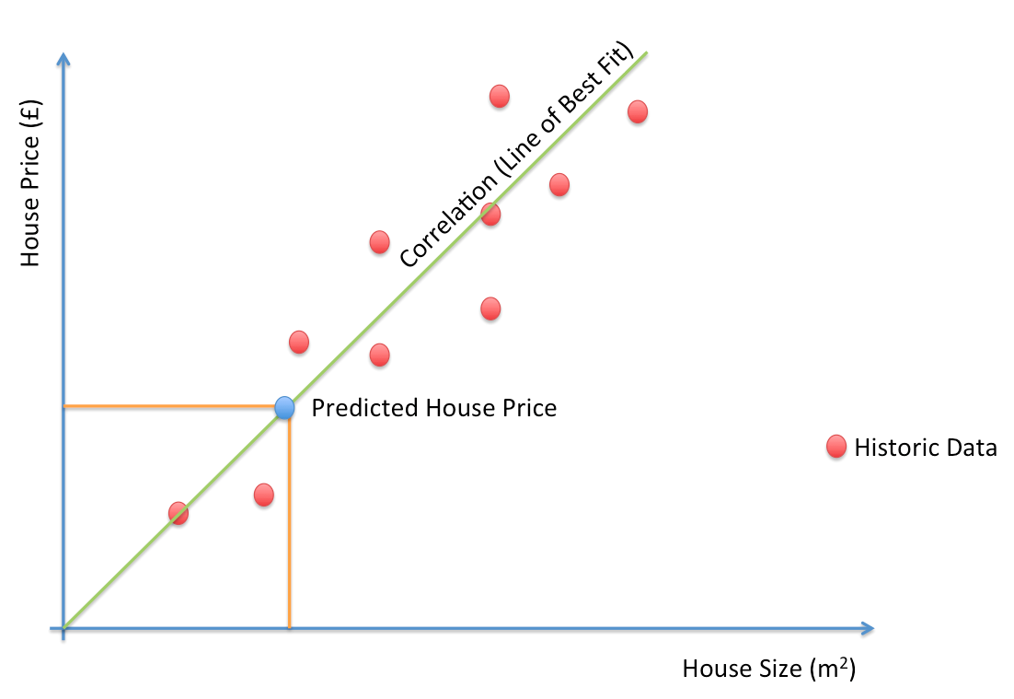

Machine Learning Tasks
Regression (“value estimation”)
Estimate (or predict), for each individual, the numerical value of some variable.
Notes:
Regression (“value estimation”) attempts to estimate or predict, for each individual, the numerical value of some variable for that individual. An example regression question would be: “How much will a given customer use the service?” The property (variable) to be predicted here is service usage, and a model could be generated by looking at other, similar individuals in the population and their historical usage. A regression procedure produces a model that, given an individual, estimates the value of the particular variable specific to that individual. Regression is related to classification, but the two are different. Informally, classification predicts whether something will happen, whereas regression predicts how
much something will happen. The difference will become clearer as the book progresses.

Slide 8
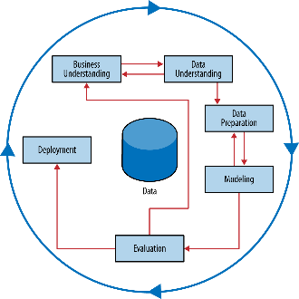
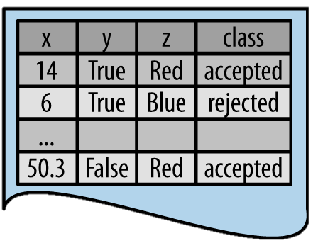
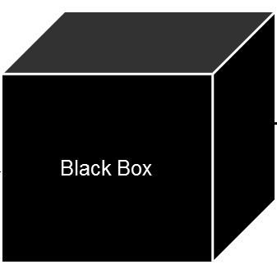
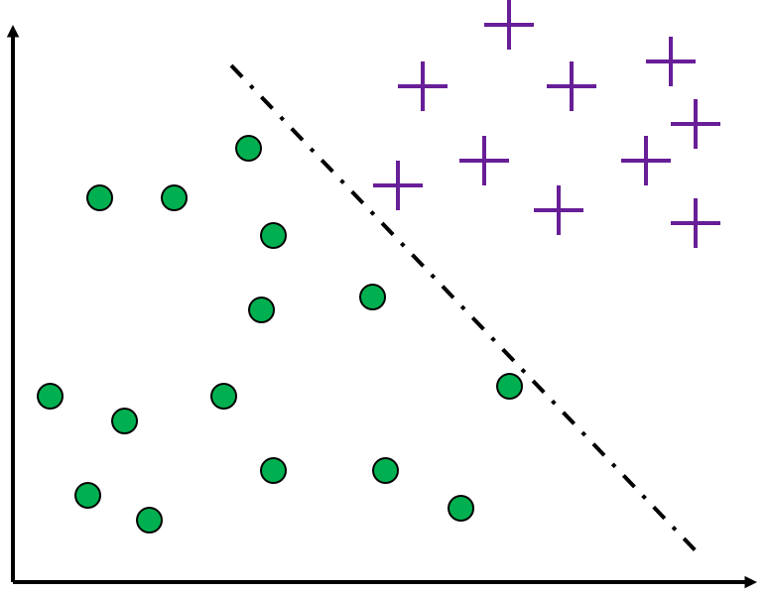
Modeling
The heart of data mining
Takes examples as input
Outputs a model of the data
Visualization of a (linear) model
Historical Data
Modelling Process
Input
Output
Notes:
Modeling is the subject of this and the next lesson so we will not dwell on it here, except to say that the output of modeling is some sort of model or pattern capturing
regularities in the data. The modeling stage is the primary place where data mining techniques are applied to the data. It is important to have some understanding of the fundamental ideas of data
mining, including the sorts of techniques and algorithms that exist, because this is the part of the craft where the most science and technology can be brought to bear.

Slide 9
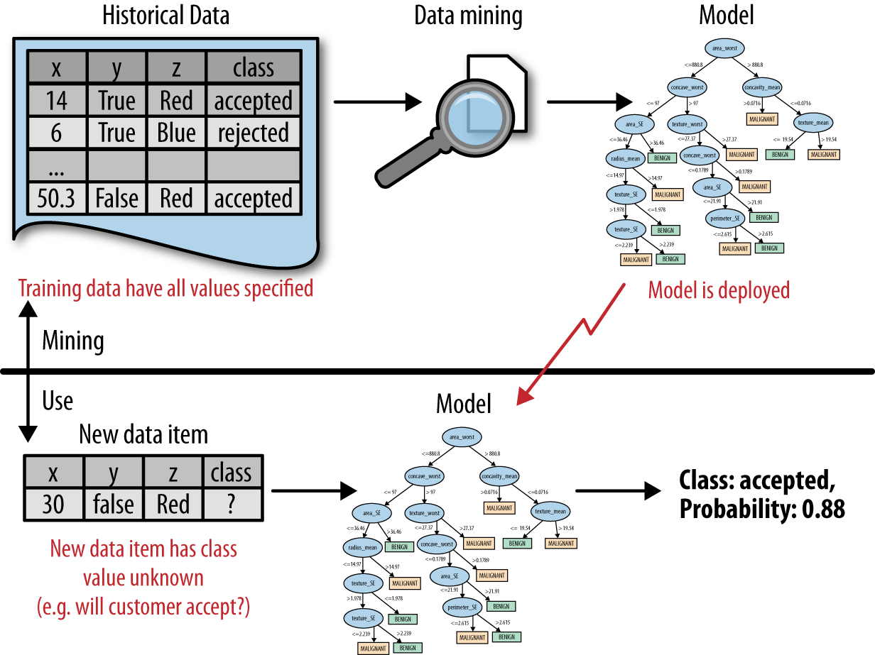
Model Creation and Model Use
Modelling Process

Slide 10
Decision Tree

Slide 11
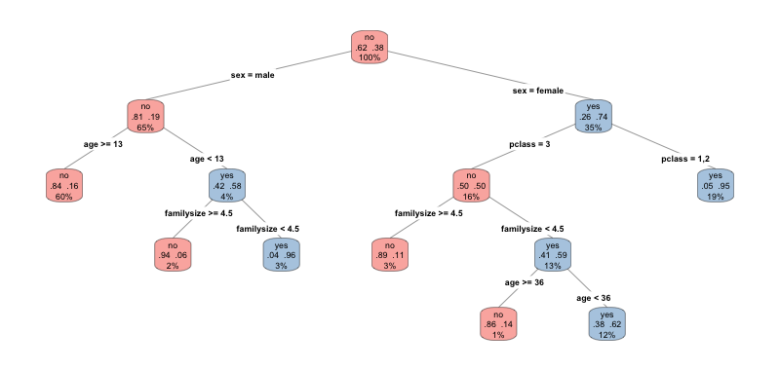
Decision Tree
Decision Trees a popular data mining technique
Why?
Easy to understand - key for communicating to non-technical decision makers
Easy to implement
Easy to use
Computationally cheap
Works remarkably well

Slide 12
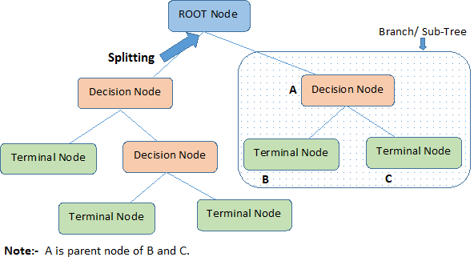
Tree Terminology
Notes:
Terminal nodes are also called leaf nodes

Slide 13
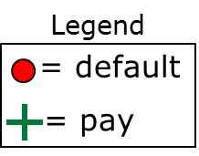
Decision Boundaries
Split on balance
Balance
<40K
>=40K
Age
Class= +
Prob.=10/12
Age
45
Split on age
<45
>=45
Class= -
Class= +
Prob.=8/9
Prob.=5/6
40K
Balance
Decision trees partition the example space with perpendicular decision boundaries
Notes:
We can visualize the decision tree in a coordinate plane where one axis is the balance and the other the age of the account holder. Each decision partitions the example space creating a perpendicular decision boundary.
A decision boundary partitions the data.

Slide 14
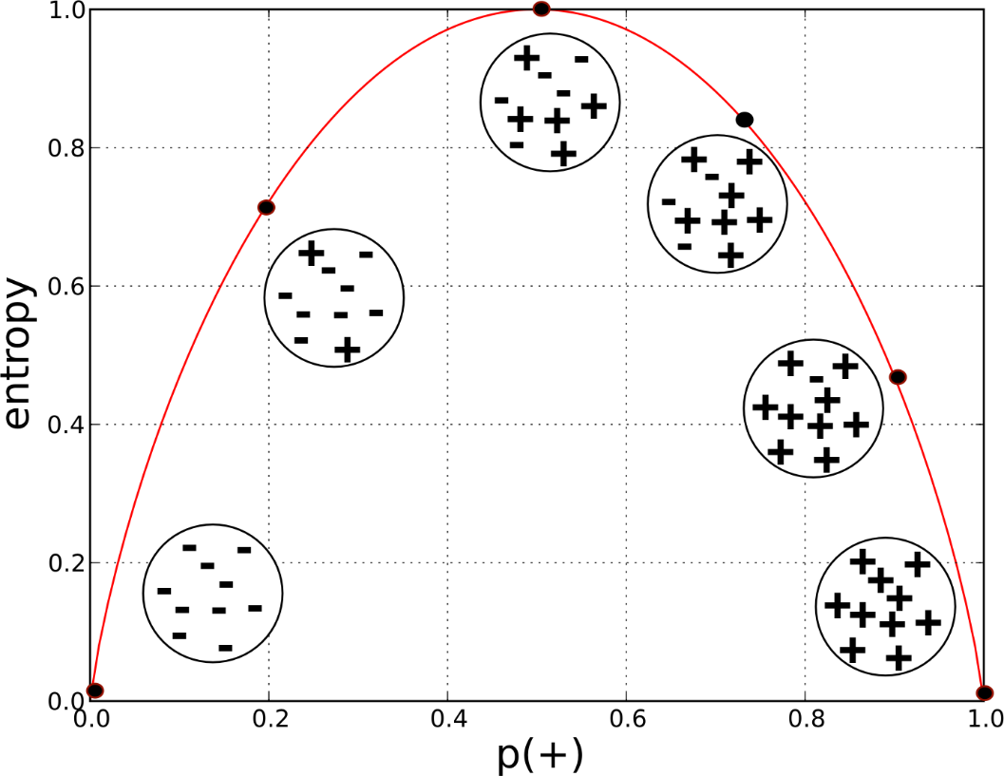
Learning(?)
Balance provided most info.
Balance
Age provided most info.
Information Gain (IG)
The change in entropy (or how much entropy was removed)
IG = ΔH
Used to compare splits on different attributes
Common decision tree splitting criteria
The more evenly distributed the split is, the more information we gain
50/50 split → lots of information
90/10 split → less information
<40K
>=40K
Class= +
Prob.=10/12
Age
<45
>=45
Class= -
Class= +
Prob.=8/9
Prob.=5/6

Slide 15
Random Forests
What if we had lots of decision trees?
Democracy!

Slide 16
Linear Classifiers

Slide 17
Can we partition a different way?
Age
45
40K
Balance
What if we weren’t limited to using line perpendicular to the axis?
Notes:
Can we find a different or better way to partition the dataset? Let’s remove the decision boundaries created by the decision tree. Once we remove the boundaries we can see that there clearly are other, possibly better, ways to partition the data set. For example, we can separate the instances almost perfectly (by class) if we are allowed to introduce a boundary that is still a straight line, but is not perpendicular
to the axes.

Slide 18
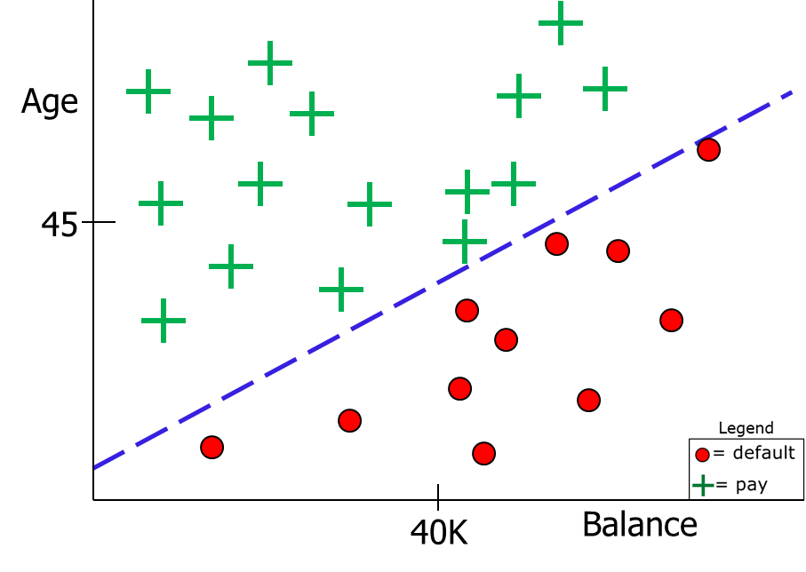

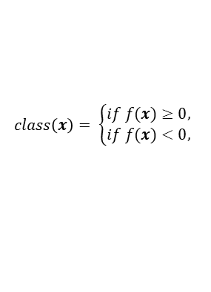

Linear classifier
Line dividing classes is called the linear discriminant.
It’s always the line created when f(x) = 0, where x is an attribute vector.
Predict class based on which side of line data point is located.
$$class\left(x\right)= \left\{\begin{aligned}if f(x)≥0, \\ if f(x)<0,\end{aligned}\right.$$
$$f\left(x\right)=−5−\frac{5}{4}∗Balance+Age=0$$
Notes:
The linear classifier serves as a decision boundary. We would classify an instance x as a + if it is above the line, and as a • if it is below the line. Rearranging our line equation mathematically leads our classification function which is also called a linear discriminate because it discriminates between the classes. The decision boundary is a linear combination – a weighted sum – of the attributes. In two dimensions, this corresponds to a line. In three dimensions, it is a plane. In higher dimensions, it is called a hyperplane. The important thing is that we can express the model as a weighted sum of the attribute values.
Whereas a decision tree creates a line for each attribute, a linear classifier creates one line that takes into account all the attributes. Again, that single line is expressed as a weighted sum of the attribute values.

Slide 19
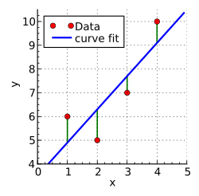

Learning
$$f\left(x\right)=−5−\frac{5}{4}∗Balance+1∗Age=0$$
The equation of the line is not arbitrary
In normal regression → minimize the “error” or “loss” between the line and the data
Called the cost or penalty function
Mean squared error is common
Can also do logit functions or others
By adjusting weights → minimize error
In classification → minimize incorrect predictions
SVMs are different but similar.

Slide 20
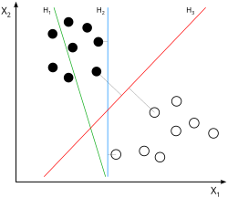
SVMs
There are infinitely lines that separate the classes
Which line do we pick?
SVMs seek to maximize the “margin” between the classes

Slide 21
Back to the point: Text Classification

Slide 22
Text Classification
Given a set of documents and labels
Can we predict the appropriate label for that document?
Document | Label
Ok | Positive
Not ok | Negative
Not not ok | Positive

Slide 23
Text Features
The problem: most ML models require features, mostly numeric features
How do we “encode” features of a sentence into numbers?
Document | Features
Ok | Length: 3 Num_words: 1 ???
Not ok | Length: 6 Num_words: 2 ???
Not not ok | Length: 10 Num_words: 3 ???

Slide 24
Count Vectorizer
Simple idea
Determine (learn) the words present in the corpus
For each document, count the num words present
Document | Ok | Not
Ok | 1 | 0
Not ok | 1 | 1
Not not ok | 1 | 2
Not not | 0 | 2

Slide 25
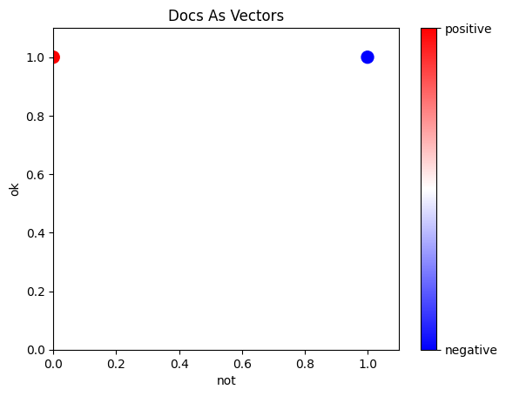
Why Vectors??
Any point can be considered a vector from the origin
Vectors have magnitude and direction
Efficient linear algebra computations
Document | Ok | Not
Ok | 1 | 0
Not ok | 1 | 1
Not not ok | 1 | 2

Slide 26
Where Am I Going With This?
Notes:
Notice the x-y axes and their values
Now that we have points in space, we can train a classifier on those points using existing models

Slide 27
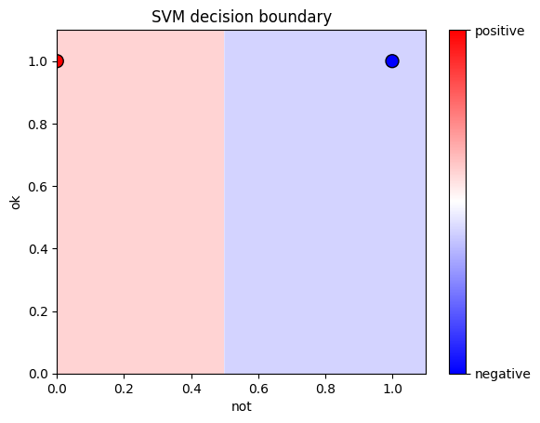
Modeling

Slide 28
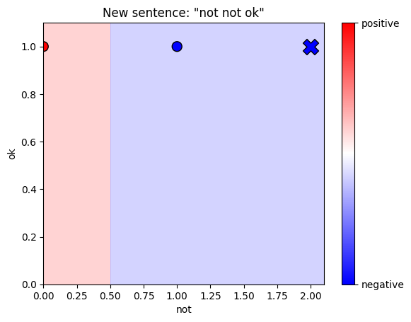
Predicting Unseen Data
Notes:
Does this make sense?
How could we

Slide 29
Other Options
Document | Ok | Not
Ok | 0.288 | 0
Not ok | 0.288 | 0.288
Not not ok | 0.288 | 0.576
Not not | 0 | 0.576
TF-IDF vectorizer
Minimizes the value of frequent words
Maximizes value of rare words
Bag of Words
Part of Speech Tagging
Topic Modeling
Word2Vec, Doc2Vec
Transformers (BERT, etc)

Slide 30
Quick Code Demo

Slide 31
A Note On SkLearn
Transformers
Fit = learning about dataset
Transform = change dataset
Classifiers
Fit = build model
Predict = make predictions

Slide 32
Questions (k-fold, performance metrics, hyperparameters)?

